Slide 1
Concept of motivation
Name:- satish delavadiya
En.no:- 160410116026
It-1,batch-b

Slide 2
What is Motivation?
*Motivation is a psychological and human aspect. It is the act of inspiring employees, peoples to devote maximum effort to achieve organizational objectives and goals.
*Motivation is defined as the process that initiates, guides and maintains goal oriented behaviors.
*It involves the biological, emotional, social and cognitive forces that activate behavior.

Slide 3
*Type of Motivation
Type of Motivation
On the basis of Source
On the basis of approach
Extrinsic Motivation
Intrinsic Rewards
Positive Motivation
Negative Motivation

Slide 4
*Extrinsic Motivation
-Extrinsic motivation refers to behavior that is driven by external rewards such as money, fame, grades, and praise.
-This type of motivation arises from outside the individual, as opposed to intrinsic motivation, which originates inside of the individual.

Slide 5
*Intrinsic Motivation
-Intrinsic motivation refers to behavior that is driven by internal rewards.
-In other words, the motivation to engage in a behavior arises from within the individual because it is intrinsically rewarding.
-This contrasts with extrinsic motivation, which involves engaging in a behavior in order to earn external rewards or avoid punishments.

Slide 6
*Positive Motivation
-Positive motivation initiates to offer rewards to persuade employees or workers by providing both monetary and non- monetary benefits.
- The positive reward can be measured in terms of money, monetary incentives increment in salary, cash rewards, bonus payment, share profit and pension and etc.

Slide 7
*Negative Motivation
-Negatives motivation initiates to hold out some punishment to employees to induce desired behavior.
-The negative motivation is measured in terms of monetary punishments, penalties, reduction of remuneration, bonus allowances, and reduction other financial incentives.
-For Efficiency we have to give positive motivation but, according to situation, negative motivation also plays important role, so it can't be avoided.

Slide 8
* MOTIVATED EMPLOYEES ARE MORE PRODUCTIVE
If employee will be satisfied and happy then he/she will do his /her work in a very impressive way, and then the result will be good, on the other hand motivated employee will motivate other employees in office.

Slide 9
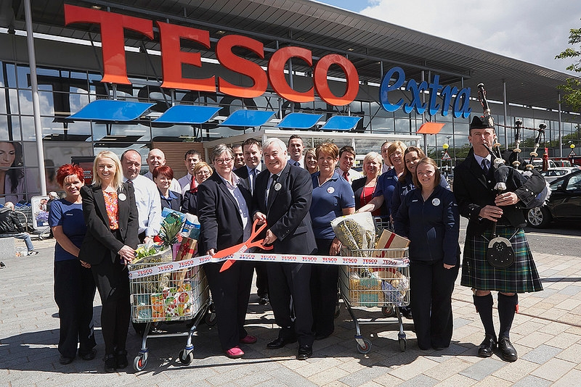
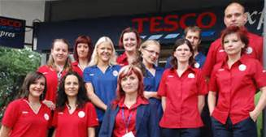
*A CASE STUDY ON “TESCO”

Slide 10
ABOUT TESCO…
•Tesco is a global grocery and general merchandise retailer headquartered in United Kingdom. It has stores in 14 countries across Asia, Europe and North America and is the grocery market leader in the UK.
•The first store opened in 1929. Since then, Tesco has expanded across the world. It now has over 2,200 stores including hypermarkets and Tesco Express outlets to meet different customer needs. As a conglomerate Tesco also offers alternative goods and services such as insurance, banking and online shopping.

Slide 11
With net profits of around £3.4 billion Tesco has become the largest British retailer. Tesco's growth has resulted in a worldwide workforce of over 468,000 employees.
To support its growth, Tesco needs staff that are motivated, flexible and welltrained and who recognize customer needs. In turn, Tesco's employees are supported by the company in their various roles and at different levels. Tesco recognizes that employee motivation is important for the continued growth of the company.

Slide 12
Thank You…

